Slide 1
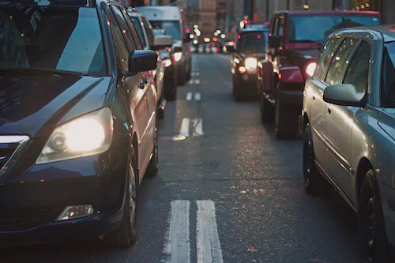

PROJECT – Vehicle Number Plate Detection and Recognition
PREPARED BY - YATRIK SHAH
SCHOOL OF EMERGING SCIENCE AND TECHNOLOGY
GUJARAT UNIVERSITY

Slide 2
OUTLINE
-> ABSTRACt
-> PROBLEM STATEMENT
-> METHODOLOGY
-> Glimpse of api
-> REAL LIFE APPLICATIONS

Slide 3
ABSTRACT
Computer vision is a field of study focused on the problem of helping computers to see. At an abstract level, the goal of computer vision problems is to use the observed image data to infer something about the world.
In huge systems of vehicle control like traffic management on highways or traffic management in big events and at highway tolls gathering information of the vehicles which were involved, by their number plates manually is very difficult so, AI can solve this problem using advanced computer vision algorithms.

Slide 4
Problem Statement
As manually number plate data collection and maintenance is very challenging and can be very time consuming task, it may not be possible to perform it on millions of vehicles.
So as a solution, we can automate it using deep learning and computer vision.

Slide 5
Methodology
-> Data Gathering
-> Data cleaning and preprocessing
-> Defining extracting bounding box in images using Deep learning
-> Model training
-> Cross validation and hyperparameter tuning
-> uSING ocr for img to text
-> Model selection
-> Frontend with HTML – css
-> Api integration with flask
-> deployment

Slide 6
REAL-LIFE APPLICATIONS
-> Fast-Track Payments at toll plazas.
-> Tracking Stolen Vehicles
-> Road safety and security systems.
-> Traffic management

Slide 7


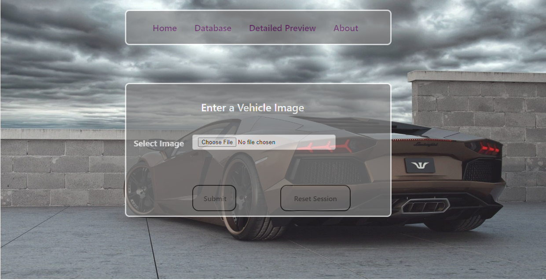



Glimpse OF API

Slide 8
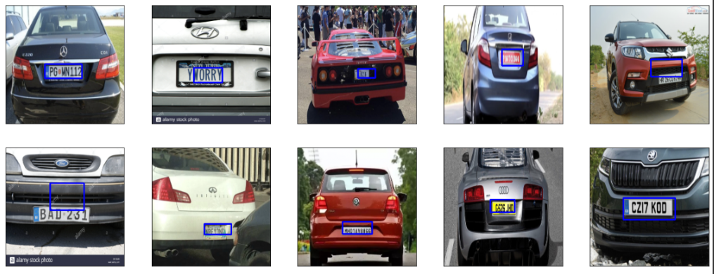
Performance of Detection Model on Test Images

Slide 9
Any
Questions?

Slide 10
THANK
YOU

